Slide 1



SuperStoreSalesDashboard
View in Power BI
Last data refresh:
6/13/2023 6:56:29 AM UTC
Downloaded at:
6/13/2023 7:46:24 AM UTC

Slide 2
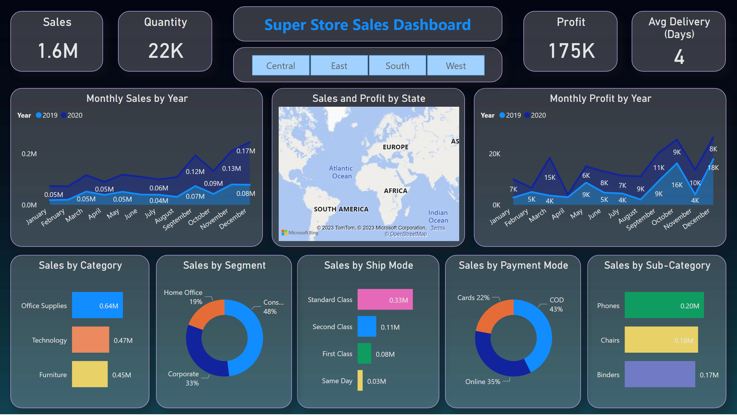
Dashboard
Notes:
Sales by Category
No alt text provided
Sales by Sub-Category
No alt text provided
Sales by Ship Mode
No alt text provided
Monthly Sales by Year
No alt text provided
Monthly Profit by Year
No alt text provided
Sales and Profit by State
No alt text provided
Sales by Segment
No alt text provided
Sales by Payment Mode
No alt text provided
slicer
No alt text provided
textbox
No alt text provided
Sales
No alt text provided
Quantity
No alt text provided
Profit
No alt text provided
Avg Delivery (Days)
No alt text provided

Slide 3
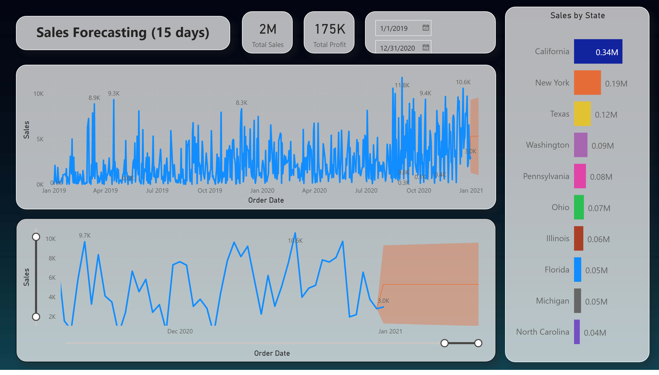
Sales Forecasting
Notes:
lineChart
No alt text provided
lineChart
No alt text provided
textbox
No alt text provided
card
No alt text provided
card
No alt text provided
Sales by State
No alt text provided
slicer
No alt text provided

